Slide 1
STATISTICS FUNDAMENTALS

Slide 2
TODAY’S LEARNING OBJECTIVES
STATISTICS FUNDAMENTALS
Use NumPy and Pandas libraries to analyze datasets using summary statistics
Visualize data to discern characteristics in a dataset
Identify a normal distribution within a dataset using summary statistics and visualization
ID variable types and complete dummy coding by hand

Slide 3
OPENING
STATISTICS FUNDAMENTALS

Slide 4

LET’S REVIEW THE DATA SCIENCE WORKFLOW

Slide 5
TODAY
We’re going to begin to talk about step 3: Parsing the Data
We’ll begin to talk about the fundamentals of Statistics

Slide 6
INTRODUCTION
DESCRIBING DATA

Slide 7
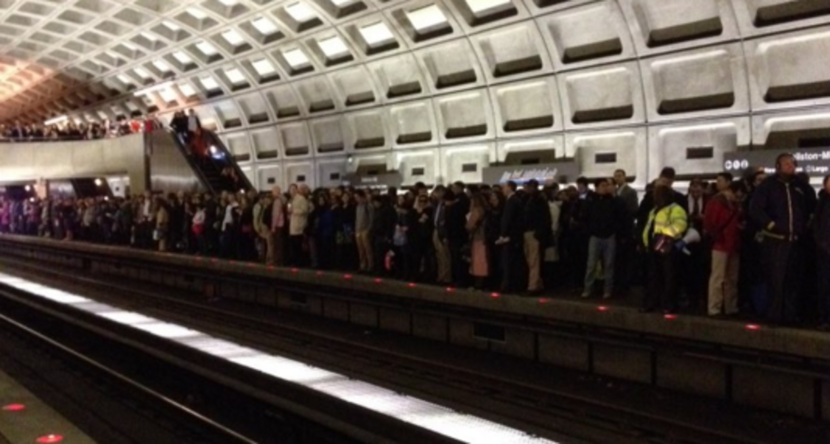
DC METRO EXAMPLE
Every night, WMATA submits a Disruptions Report representing any significant disruptions in metro service that day. You can find the dataset here (http://opendatadc.org/dataset/wmata-disruption-reports).
Let’s take a look at the disruptions they recorded for the weekend of 8/20.

Slide 8
DC METRO EXAMPLE
Day | Time | Color Line | Station | Delay
8/20/2016 | 8:24 a.m. | Green | Branch Avenue | 6
8/20/2016 | 11:37 a.m. | Red | Grosvenor | 18
8/20/2016 | 12:00 p.m. | Red | Glenmont | 4
8/20/2016 | 2:28 p.m. | Yellow | Ft. Totten | 12
8/20/2016 | 2:40 p.m. | Red | Glenmont | 4
8/20/2016 | 3:04 p.m. | Red | Grosvenor | 4
8/20/2016 | 5:14 p.m. | Orange | New Carrollton | 22
8/21/2016 | 9:15 a.m. | Red | Silver Spring | 8
8/21/2016 | 9:15 a.m. | Red | Silver Spring | 8
8/21/2016 | 11:32 a.m. | Blue | Franconia-Springfield | 2
8/21/2016 | 1:56 p.m. | Silver | Largo Town Center | 8
How would you use this data to describe
the delays on the Metro that weekend?

Slide 9
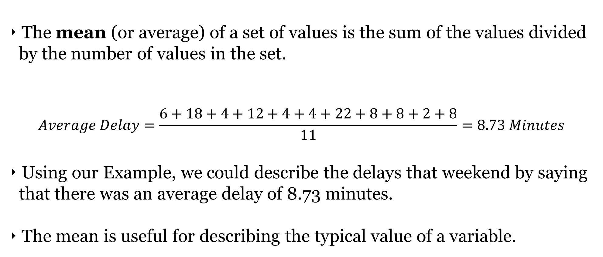
MEAN

Slide 10
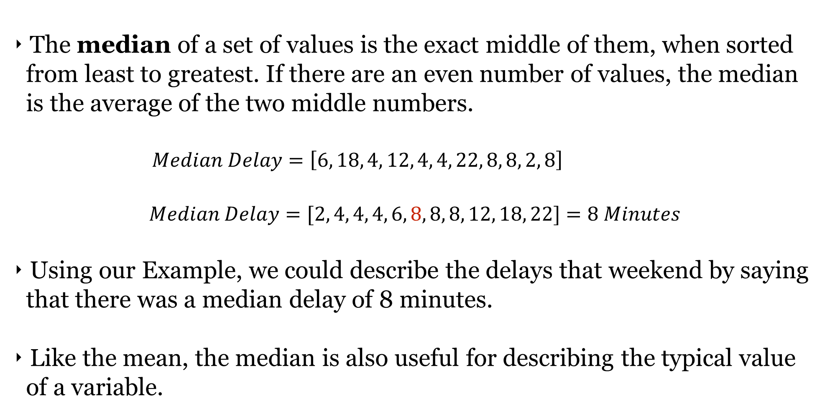
MEDIAN

Slide 11
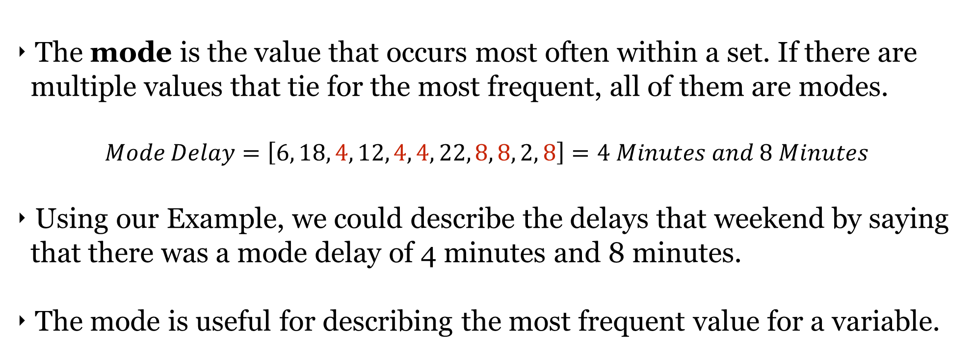
MODE

Slide 12
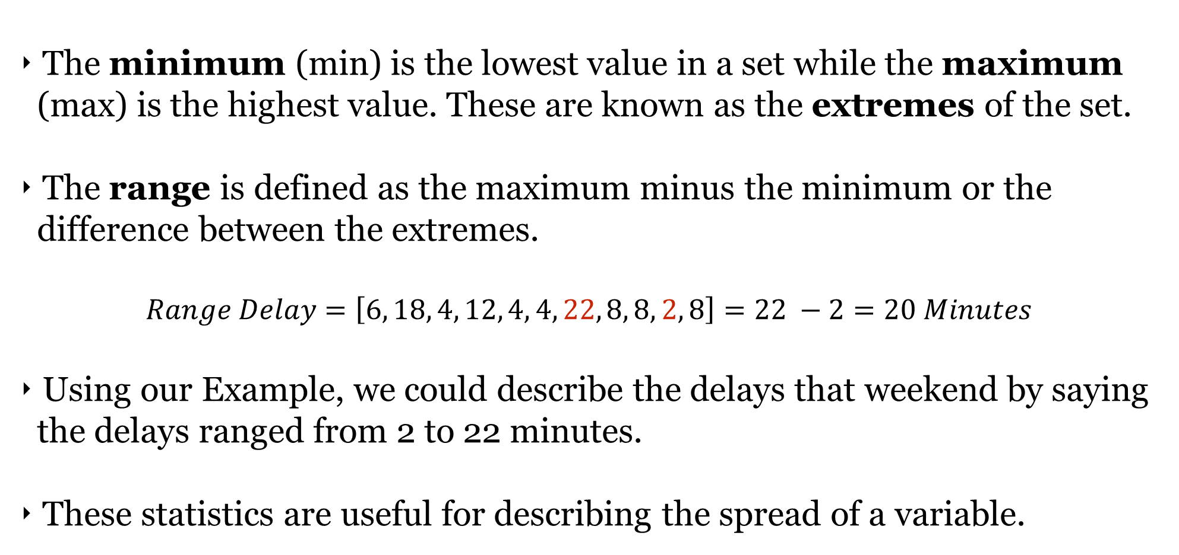
MINIMUM, MAXIMUM, & RANGE

Slide 13
QUARTILES
Quartiles separate your set into four subsets based on the relative magnitude of the values. For example, the first quartile (Q1) represents the 25% of the data with the lowest values.
How To Find Quartiles
Rank your values by magnitude.
Calculate the Median.
Divide the values in two subsets.
If there are even number of values, make two equal subsets.
Otherwise, include the median in both subsets.
Find the medians of the two subsets.

Slide 14
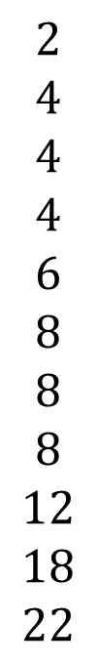
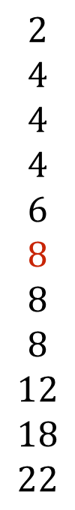
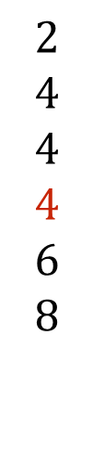
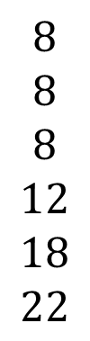
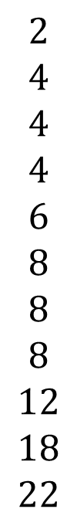
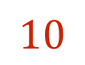
QUARTILES
1
2
3
4
Q1
Quartile | Value
Q1 | 4
Q2 (Median) | 8
Q3 | 10
Q4 (Maximum) | 22
Q2
Q3
Q4

Slide 15
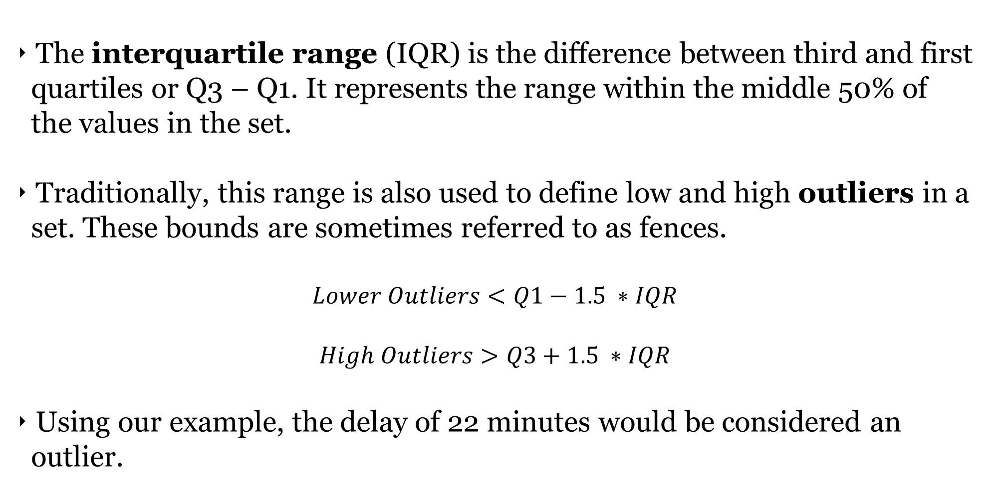
IQR AND OUTLIERS

Slide 16
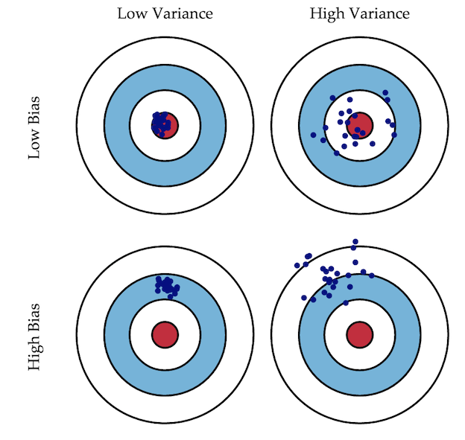
VARIANCE AND STANDARD DEVIATION
Variance represents how much values in the set may deviate or vary from its mean. A high variance indicates that values in the set are regularly far from the mean while a low variance indicates that they are tightly spaced around the mean.
Standard deviation is just the square root of variance.

Slide 17
VARIANCE AND STANDARD DEVIATION
Using our example, the variance of the delays is about 39.42 minutes² and the standard deviation is 6.28 minutes.
Note that variance is always measured in squared units and standard deviation is measured in units. As a result, standard deviation is usually more interpretable.

Slide 18
CODEALONG (PART 1)
SUMMARY STATISTICS

Slide 19
INTRODUCTION
DISTRIBUTIONS

Slide 20
DISTRIBUTIONS
A distribution is how statistics translates the frequency of each value in a set to the probability (or likelihood) that each value will appear in the set.
The probability of a value is the likelihood that it occurs in the set while the cumulative probability is the likelihood that any value less than or equal to it occurs in the set.
Delay | Frequency | Probability | Cumulative Probability
2 | 1 | 1/11 | 1/11
4 | 3 | 3/11 | 4/11
6 | 1 | 1/11 | 5/11
8 | 3 | 3/11 | 8/11
12 | 1 | 1/11 | 9/11
18 | 1 | 1/11 | 10/11
22 | 1 | 1/11 | 11/11

Slide 21
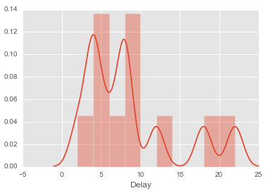
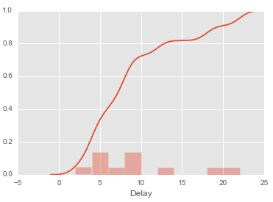
VISUALIZING DISTRIBUTIONS
Here’s how these probability distributions look:
You can see how the modes have a large effect on both distributions.

Slide 22
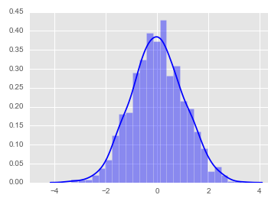
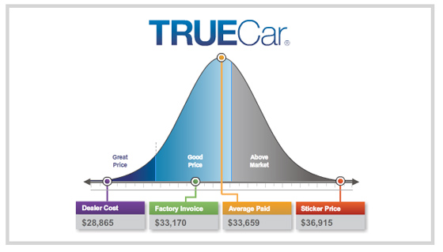
THE NORMAL DISTRIBUTION
The normal distribution (or “bell curve”) is defined as the distribution of values where they are evenly spaced around the mean or when the median equals the mean equals the mode.
It is the most important distribution in statistics because it has a series of mathematical properties that we can use for building complex models.

Slide 23
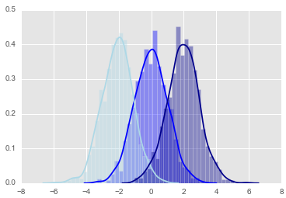
THE NORMAL DISTRIBUTION
The normal distribution is defined by two key parameters– mean and standard deviation.
Changing the mean of the normal distribution shifts it back and forth along the x-axis while changing the standard deviation alters height of the distribution.

Slide 24
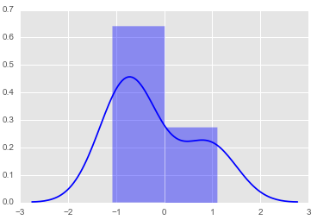
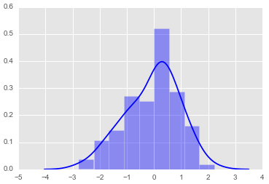
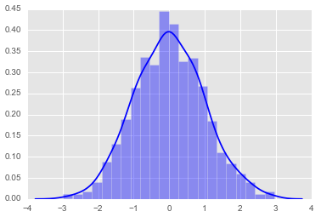
CENTRAL LIMIT THEOREM
The normal distribution is also important because of something called central limit theorem which states that as the sample size of data increases, the distribution of the data will become roughly normal.
Sample Size = 10
Sample Size = 100
Sample Size = 1000

Slide 25
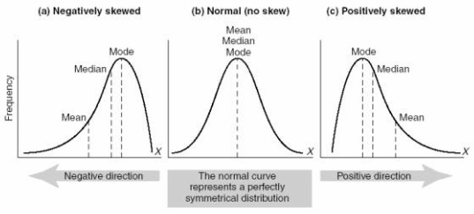
DESCRIBING NON-NORMAL DISTRIBUTIONS
It will often be the case that distribution of real-world data will not be normal due to the nature of how it was collected or measured. As a result, it helps to be able to describe the abnormalities.
Skew is when data is not symmetric around the mean, but more heavily concentrated above or below the mean.

Slide 26
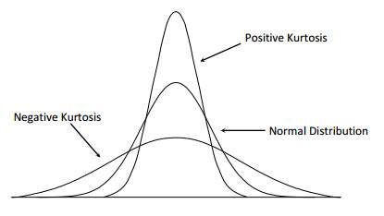
DESCRIBING (NON-)NORMAL DISTRIBUTIONS
Kurtosis refers to the peak and general shape (pointy vs flat) of the distribution curve.
Note that unlike skew normal distributions can have positive or negative kurtosis.

Slide 27
CODEALONG (PART 2)
DISTRIBUTIONS

Slide 28
DETERMINING THE DISTRIBUTION OF YOUR DATA
Open the dc-metro-delays notebook located in lessons/lesson-03/code of the class repo.

Slide 29
INTRODUCTION
VARIABLE TYPES

Slide 30
VARIABLE TYPES
There are two types of variables – numeric/continuous and categorical/discrete.
Numeric/continuous variables can are measured across a large range of quantitative values (e.g. height, income).
Categorical/discrete variables are measured using several specific values that have no sensible intermediary values (e.g. hair color).
Some models will only accept numeric variables and others will accept both numeric and categorical data so it’s important to know what variables we’re working with.

Slide 31

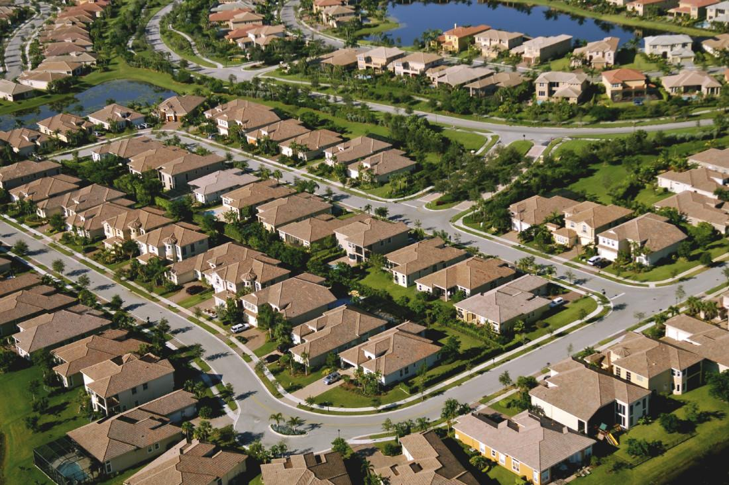

CLASS/DUMMY VARIABLES
Let’s say we have a categorical variable area, which takes on one of the following values: rural, suburban, and urban.
If we needed to represent these numerically for a model, how would we represent this variable?

Slide 32
CLASS/DUMMY VARIABLES
Does an ordinal coding scheme (0=rural, 1=suburban, and 2=urban) work for our model?
Not likely because of the two following problems:
Are urban areas 2x suburban areas? What does that even mean?
Is there a reason that we ordered the variables in this way?

Slide 33
CLASS/DUMMY VARIABLES
The solution is something called dummy variables where we convert the area variable into a series of binary (0/1) variables.
We’ll need n-1 dummy variables where n is the number of unique values or levels of our categorical values.
 | area_urban | area_suburban
rural | 0 | 0
suburban | 0 | 1
urban | 1 | 0

Slide 34
CODEALONG (PART 3)
VARIABLE TYPES

Slide 35
CODEALONG (PART 4)
MATRIX & APPLICATION

Slide 36
CONCLUSION
TOPIC REVIEW

Slide 37
REVIEW
We talked about several different types of summary statistics, what are they?
We covered several different types of visualizations; which ones?
We talked about the normal distribution; how do we determine your data’s distribution?

Slide 38
LESSON
Q & A

